Slide 1

Defense Corona: Android App
Presented by Md. Monir Ahammod 16CSE061 Department of Computer Science and Engineering BSMRSTU
Computer Science and Engineering

Slide 2
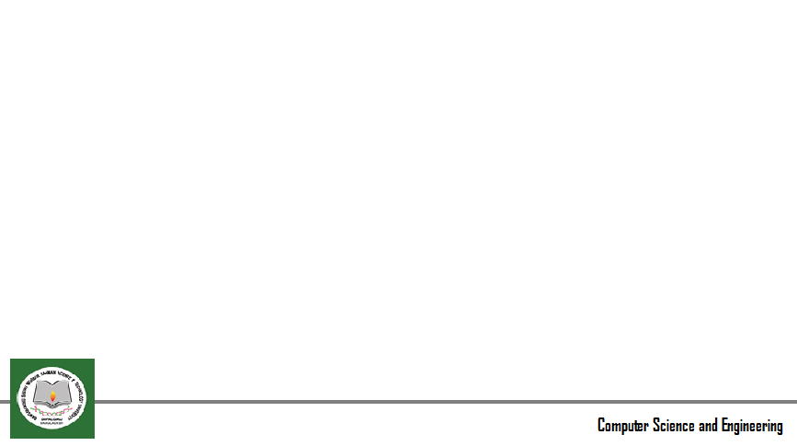
Contents
Introduction
Motivation
Cough Sound Counter
Symptom Analysis
Methodology
Conclusion
Conclusion
Q and A

Slide 3

Introduction
Name: Defense Corona
Objective: Developing an Android app to detect cough sounds and provide a basic symptom analysis for COVID-19.
Prototype app: Created using Android Studio (JAVA).
Feature: Cough Sound Counter

Slide 4
Cough Sound Counter
Description: The app will count the number of cough sounds when the user opens it.
Inspiration: Found a similar feature in the "Live Transcribe" app.
Live Transcribe app: Source code available on GitHub (URL: https://github.com/google/live-transcribe-speech-engine).
Use the microphone sensor as a cough sound detector.
Possible implementation: Firebase or voice API.

Slide 5
Cough Sound Counter (continued)
App Behavior: When the user coughs, a notification will be displayed at the bottom of the app, indicating that a cough has been detected.
Not a translator: The app's main focus is not translation but rather cough sound detection.
App Scope: The current version is a prototype; further features will be added.

Slide 6
Project Scope
Importance: The project aims to contribute to the detection and prevention of COVID-19.
Size: The app has significant potential for expansion.
Additional features: Cough sound counter is the immediate requirement, followed by other planned features.

Slide 7
Symptom Analysis
Feature: Users can select multiple symptoms.
Analysis: The app will generate a report indicating whether the user might have COVID-19 based on the selected symptoms.
Empowering users: Providing initial insights to help users assess their condition.

Slide 8
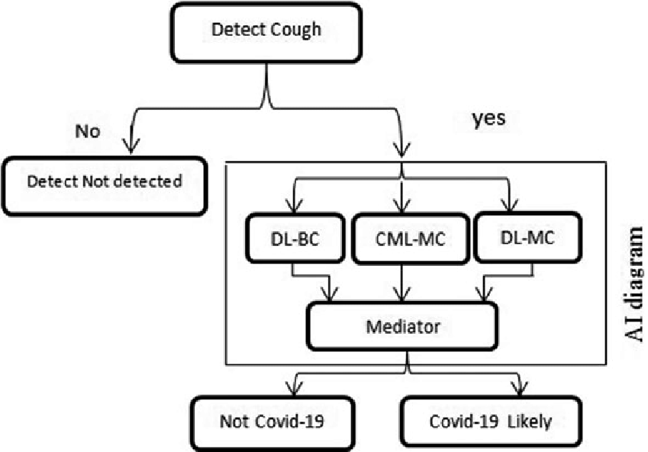
Methodology

Slide 9
Conclusion
Recap: Defense Corona app is an Android app focused on detecting cough sounds and providing symptom analysis for COVID-19.
Collaborative approach: Requesting assistance to add the cough sound counter feature by incorporating code from the "Live Transcribe" app.
Future prospects: Expanding the app's functionalities and empowering users in the fight against COVID-19.

Slide 10
Contact Information
Md. Monir Ahammod
Email: monirahammod097@gmail.com
LinkedIn: https://www.linkedin.com/in/monirahammod/
Website: https://monircse061.github.io/page/
Cell: +8801757128711

Slide 11
Q&A
Any Question?

Slide 12
Thanks All

